Slide 1
Comparison Of Implementations
VS’ Basic API To Expert API

Slide 2
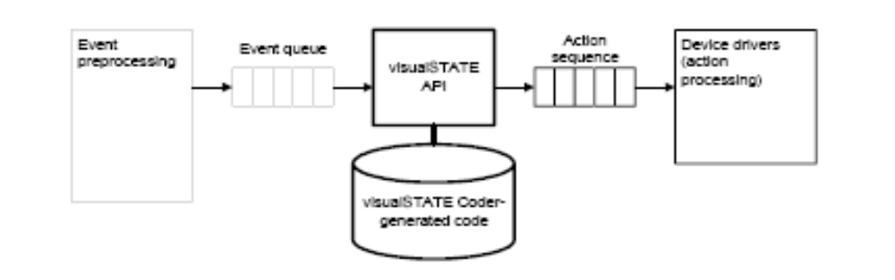
Use Of An API
In a visualSTATE embedded application, the following categories of code are
required:
    visualSTATE Coder-generated code
    visualSTATE API
    User-written code: Manually written code for event preprocessing, event queues,device drivers, action functions, and code for calling the functions in the visualSTATE API.

Slide 3
Types Of API
Basic API Offers highest speed and lowest memory consumption compared to the Expert API. It handles visualSTATE Projects that contain a single visualSTATE System.
Expert API Can handle visualSTATE Projects that contain multiple visualSTATE Systems.
Expert DLL is a dynamic link library. It is a binary version of the visualSTATE Expert API that can load visualSTATE. Projects containing a single visualSTATE System from disk. For example, the Expert DLL can be used for debugging visualSTATE applications on a PC via programming languages such as Visual Basic and Pascal.

Slide 4
The Tempting Idea At First
Since the Expert API can handle more than one system (which maps to modules in SOS) it might be a nice idea to have a the expert API loaded in a modules which may dynamically bind to the system at run time and save on code space as compared to the basic API. Due to the principle of reentrancy, simultaneous calls made to the same API function will not cause problems as long as none of the simultaneous calls use the same System contexts as parameters to the function in question.

Slide 5
Comparison
The Basic API can only handle VS Projects containing a single VS System.
The Expert API can load visualSTATE Systems from diskand handle VS Projects containing multiple visualSTATE Systems.
For VS Projects containing a single VS System, it is recommended to use the Basic API because it is the most effective API of the two.

Slide 6
The Issue
Expert API loads VS systems by connecting to a table in the VS system.
The existence of a single global system context variable which is accessed by the system. Or use of parameters which use other implicit details not passed in the pointers causes implementation issues
Further since modules map to systems each module will have only one system and it does not make sense to implement the expert API in the other fashion either.

Slide 7
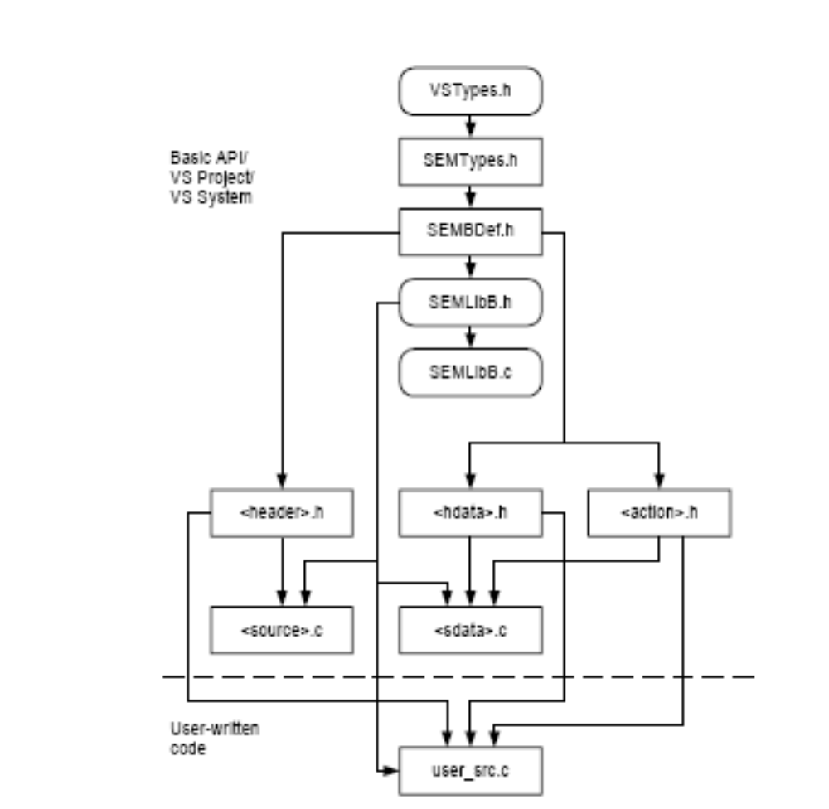
The APIs

Slide 8
